Slide 1
FIRST EXPERIENCE IN NAIROBI
An adventure in Nairobi

Slide 2
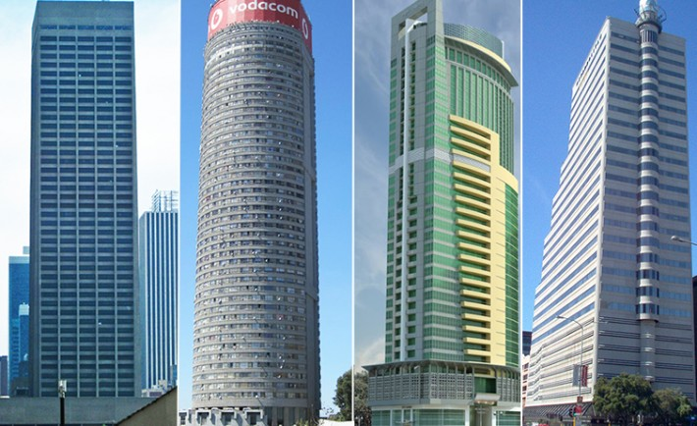
The city of high buildings.
The first thing I noticed once I arrived in Nairobi was the good looking buildings all over the city.
The most amazing thing about the tall buildings is that I saw the well known building.(KICC)

Slide 3
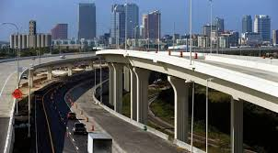
Nairobi’s double-decker roads
The roads in Nairobi were smooth and well constructed with streetlights along the road.
Some roads were double-decker and all that made it look attractive and creative.

Slide 4
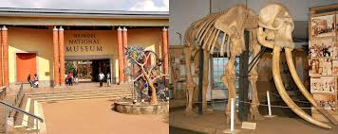
Recreational places in Nairobi
In Nairobi I saw different recreational places where people go to free their minds and also learn.
I also found it encouraging how people were coming in and out of the recreational places showing they appreciate our culture.

Slide 5
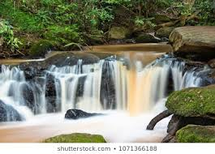
The beauty of nature in Nairobi
The Nairobi River was the most amazing natural feature I saw in Nairobi.

Slide 6
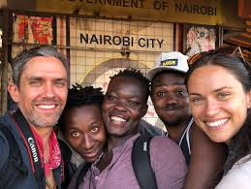
Different blend of people in Nairobi
In this famous city I noticed different varieties of people.
I noticed there were white people, those included; Indians, Chinese, Japanese etc.
This showed how Nairobi is in good condition that even foreigners come either to live or work there

